Slide 1


Syllabus Overview
Module 1 thru 10

Slide 2
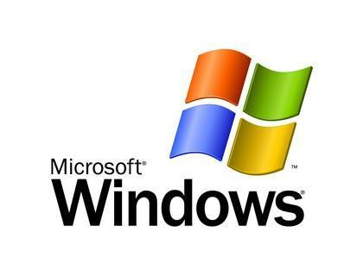
Module 1 – Understanding of Microsoft Windows
What is Windows?
Different Versions of Windows
Microsoft Background and Products
Windows Market Share - Everyday Windows
Windows vs. Linux vs. MAC
Quiz, Handouts and Homework
By: Imran Afzal

Slide 3

Module 2 – Setting up a Lab
Oracle Virtual Box
Installing Oracle Virtual Box
Creating First Virtual Machine
Quiz, Handouts and Homework
By: Imran Afzal

Slide 4
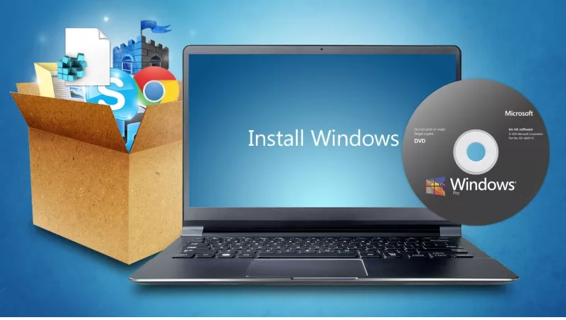
Module 3 - Windows Installation and Configuration
Different Ways to Install OS
Downloading Windows Server 2016
Installing Windows Server 2016
Adding Resources
Hostname and System Information
Windows Server GUI Overview
Quiz, Handouts and Homework
By: Imran Afzal

Slide 5


Module 4 - System Access and File System
Accessing Windows System
File System and Description
Navigating to File System
File Types and Creation
File Properties
Finding Files and Directories
File Maintenance (copy, delete, move and rename)
Files Operations
File Editing Short-Cut Keys
Quiz, Handouts and Homework
By: Imran Afzal

Slide 6
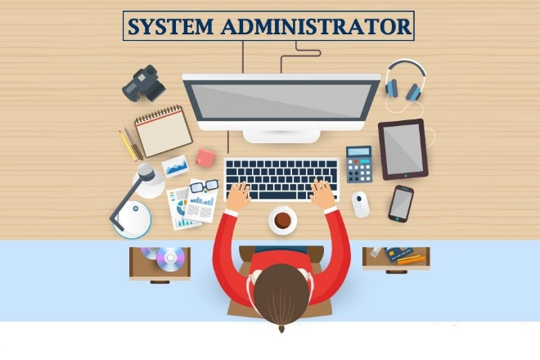
Module 5 - System Administration
User Account Management
Elevating User Roles
Monitor Users Activity (Task manager and command line)
System Utilities Under Accessories
Programs and Service Management (Control panel and services)
System Resource Monitoring (Task Manager)
Windows Event Logs
System Maintenance
By: Imran Afzal

Slide 7
Module 5 - System Administration…
Jobs and Schedules
Windows Settings
Server Manager Dashboard
Installing and Uninstalling Programs
Windows Applications (Microsoft or 3rd Party)
Windows Short-Cut Keys (e.g. Alt+Ctl+Del etc.)
Check System Hardware
Quiz, Handouts and Homework
By: Imran Afzal

Slide 8

Module 6 - Advance Windows Administration
Roles vs. Features
Adding Roles and Features
What is Domain Controller?
Domain Controller and Active Directory
Active Directory Prerequisites
What is DNS?
Active Directory Installation
Active Directory "Users and Computers“
Active Directory User Account Management
By: Imran Afzal

Slide 9
Module 6 - Advance Windows Administration…
Installing Windows Client
Joining the Domain from Windows 7 and 10
Active Directory "Administrative Center“
Active Directory "Domain and Trust“
Active Directory "Module for Windows PowerShell“
Active Directory "Site and Services“
Group Policy Management
DNS Administration
Web Server (IIS) Installation
Quiz, Handouts and Homework
By: Imran Afzal

Slide 10
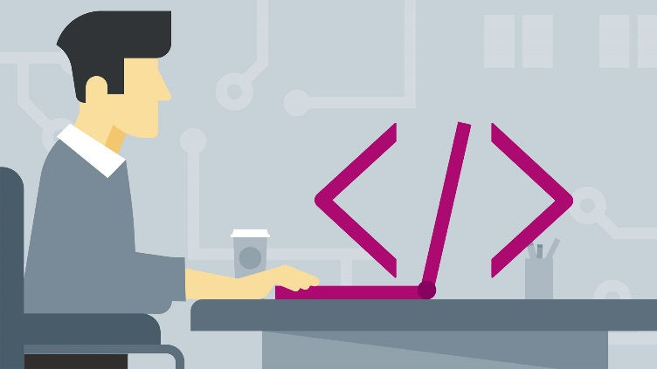
Module 7 - Windows Scripting and Command Line
Windows Batch Scripting
First Batch Script "Hello World“
Script to Automate Simple Tasks
Windows PowerShell
Windows PowerShell Commands
Windows PowerShell ISE (Integrated Scripting Environment)
Windows Management Instrument (WMIC)
Difference Between DOS and PowerShell
Quiz, Handouts and Homework
By: Imran Afzal

Slide 11

Module 8 - Networking and System Updates
What is NIC?
Enable Internet on the VM
NIC Teaming
Network Configuration
Windows Updates
NTP Configuration
File Transfer Methods
FTP Server Installation and Configuration
Sharing FileSystem (Samba or NFS)
WSUS Server Installation and Configuration
Windows Firewall
Quiz, Handouts and Homework
By: Imran Afzal

Slide 12

Module 9 – Storage Management
What is Computer Storage?
Type of Computer Storage
How to Add Disk
Extend an Existing Disk
Disk Cleanup and Defragmentation
RAID
Windows Backup and Restore
Quiz, Handouts and Homework
By: Imran Afzal

Slide 13

Module 10 - Additional Resources (Bonus)
What is IT?
IT Components
Facts about IT
IT Management Jobs
Resume Workshop
Interview Workshop
Post Resume and What to Expect
VMWare Workstation Player Download and Installation
Install Oracle VirtualBox on MAC
Quiz, Handouts and Homework
By: Imran Afzal

